Slide 1
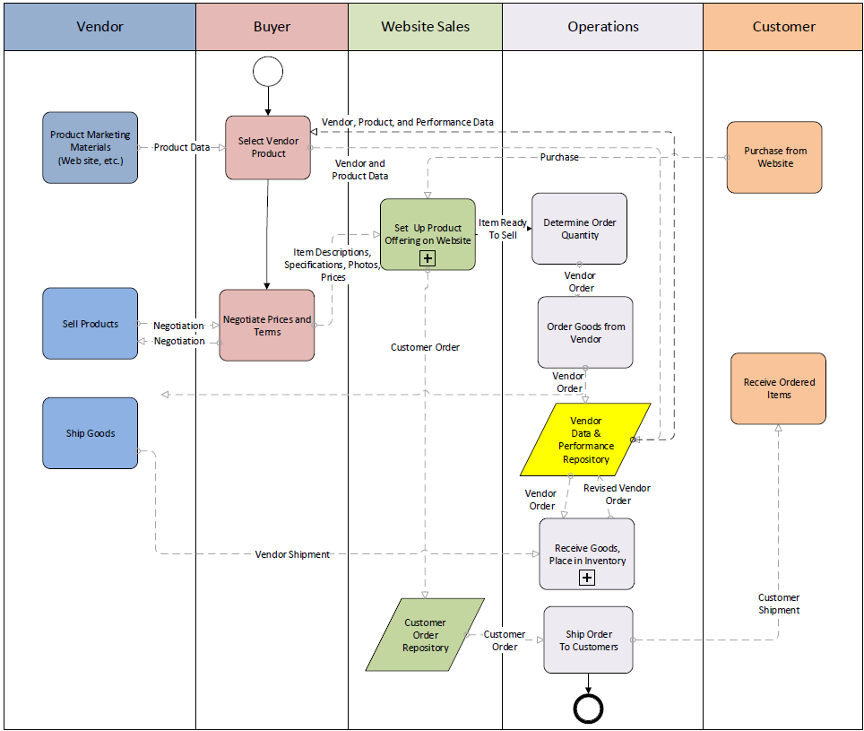
Copy of Figure 2-8

Slide 2


Start
End
Activity
Sub-process
Data repository
Data flow
Sequence flow
Process Symbols (BPMN Standard)
Figure 2-3

Slide 3
Website Sales
Operations
Customer
Customer order
repository
Customer order
Retrieve order
Order
details
Items
repository
Order
items
Shipping
details
Gather items
Package shipment
Order
complete
Convey to shipper
Customer shipment
Receive items ordered

